Slide 1
A High-Speed Elliptic Curve Cryptographic Processor for Generic Curves over GF(p)
Yuan Ma, Zongbin Liu, Wuqiong Pan, Jiwu Jing
State Key Laboratory of Information Security,
Institute of Information Engineering, CAS, Beijing, China
SAC 2013

Slide 2
Outline
Introduction
Processing Method
Proposed Architecture
Implementation and Comparison
Conclusion and Future Work

Slide 3
Outline
Introduction
Processing Method
Proposed Architecture
Implementation and Comparison
Conclusion and Future Work

Slide 4
Motivation
People like to use ECC because...
Smaller Key sizes
Faster implementation
Less storage and power consumption

Slide 5
Motivation
Our goal...
Getting the fastest ECC hardware implementation for generic curves over GF(p)
Applicable to FPGAs and ASICs

Slide 6
Hierarchy of Operations
Double&Add, Window, NAF,
Montgomery ladder...
Affine coordinates,
Projective Jacobian coordinates...
Montgomery multiplication,
Fast reduction...

Slide 7
Previous Works for ECC Implementations
For generic curves
Guillermin [1]
based on RNS (Residue Number System)
the fastest one(0.68 ms for 256-bit PM on Stratix II)
Side channel analysis (SCA) resistance
large area
For specific curves
Güneysu et al. [3]
NIST primes, fast reduction
faster than [1] (0.49 ms for 256-bit PM on Virtex-4)
limited in FPGAs, restricted in NIST prime field
Mentens [2]
based on traditional Montgomery multiplications
2.35 ms for 256-bit PM on Virtex-2 Pro
SCA resistance
Low frequency
[1]Guillermin, N.: A high speed coprocessor for elliptic curve scalar multiplications over Fp . CHES 2010
[2] Mentens, N.: Secure and ecient coprocessor design for cryptographic applications on FPGAs. PhD thesis
[3]Güneysu, et al.: Ultra high performance ECC over NIST primes on commercial FPGAs. CHES 2008

Slide 8
Previous work for Montgomery multiplication
radix-2 based
high-radix based: significantly reducing clock cycles, thus faster
in approximately 2n clock cycles, such as systolic array architectures
in approximately n clock cycles, but at a low frequency, such as [2]
Our primary goal
Designing a new Montgomery multiplication architecture which is able to simultaneously process one Montgomery multiplication within approximately n clock cycles and improve the working frequency to a high level
Key techniques
the parallel array architecture with one-way carry propagation can efficiently weaken the data dependency for calculating quotients, yielding that the quotients can be determined in a single clock cycle
a high working frequency can be achieved by employing quotient pipelining inside DSP blocks

Slide 9
Outline
Introduction
Processing Method
Proposed Architecture
Implementation and Comparison
Conclusion and Future Work

Slide 10
Pipelined Montgomery Algorithm
Orup, H.: Simplifying quotient determination in high-radix modular multiplication. In: IEEE Symposium on Computer Arithmetic. 1995

Slide 11
DSP Blocks

Slide 12
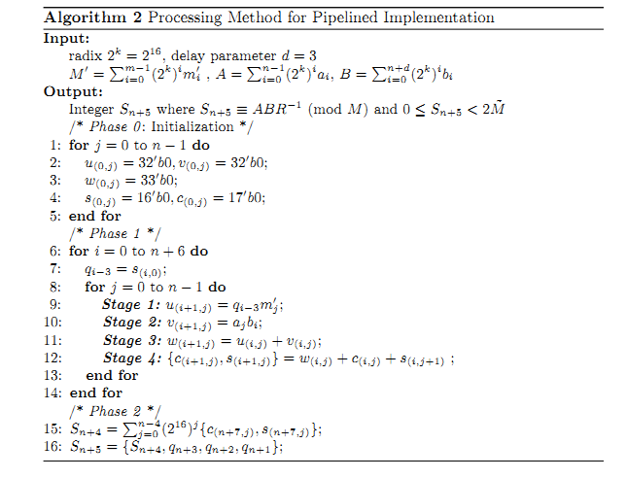
Processing Method for Pipelined Implementation

Slide 13
Outline
Introduction
Processing Method
Proposed Architecture
Implementation and Comparison
Conclusion and Future Work

Slide 14
Montgomery Multiplier
Processing Element (PE)

Slide 15
PE Array

Slide 16
Redundant Number Adder

Slide 17
ECC Processor Architecture

Slide 18
Elliptic Curve Arithmetic
Modular Adder/Subtracter
straightforward integer addition/subtraction without modular reduction
As an alternative, the modular reduction is performed by the Montgomery multiplication with an expanded R
Point Doubling and Addition
Jacobian projective coordinates
successive multiplications can be performed independently
A + B mod M → A + B ∈ (0,8M)
A－B mod M → A － B + 4M ∈ (0,8M)

Slide 19
SCA Resistance
randomized Jacobian coordinates method against DPA
executed only twice or once
no impact on the area and little decrease in the speed
a window method presented in [4] against SPA
2^{w－1}＋ tw point doublings and 2^{w－1}＋t－1 point additions, window size w, the number of words t
implemented by block RAMs which are abundant in modern FPGAs
acceptable for our design
Möller, B.: Securing elliptic curve point multiplication against side-channel attacks. In ISC 2001.

Slide 20
Outline
Introduction
Processing Method
Proposed Architecture
Implementation and Comparison
Conclusion and Future Work

Slide 21
Hardware Implementation
Our ECC processor for 256-bit curves named ECC-256p is implemented on Xilinx Virtex-4 and Virtex-5 FPGA devices
The addition width is set to 54
w is set to 4. One point multiplication requires 264 doublings and 71 additions at the cost of a pre-computed table with 15 points
The critical path of ECC-256p is the addition of three 32-bit number in the PE
The final inversion at the end of the scalar multiplication is taken into account

Slide 22
Results After PAR
Operation | ECC-256p
MUL | 35 (average 29)
ADD/SUB | 7
Point Doubling (Jacobian) | 232
Point Addition (Jacobian) | 484
Inversion (Fermat) | 13685
Point Multiplication (Window) | 109297
Clock
cycles
 | Virtex-4 | Virtex-5
Slices | 4655 | 1725
LUTs | 5740 (4-input) | 4177 (6-input)
Flip-flops | 4876 | 4792
DSP blocks | 37 | 37
BRAMs | 11 (18 Kb) | 10 (36 Kb)
Frequency (Delay) | 250 MHz (0.44 ms) | 291 MHz (0.38 ms)
Area
and
Speed

Slide 23
Performance Comparison
 | Curve | Device | Size (DSP) | Frequency | Delay | SCA res.
Our | 256 any | Virtex-5 | 1725 Slices (37 DSPs) | 291 MHz | 0.38 ms | Yes
Work | 256 any | Virtex-4 | 4655 Slices (37 DSPs) | 250 MHz | 0.44 ms | Yes
[1] | 256 any | Stratix II | 9177 ALM (96 DSPs) | 157 MHz | 0.68 ms | Yes
[2] | 256 any | Virtex-2 Pro | 3529 Slices (36 MULTs) | 67 MHz | 2.35 ms | Yes
[5] | 256 any | Virtex-2 Pro | 15755 Slices (256 MULTs) | 39.5 MHz | 3.84 ms | No
[3] | 256 NIST | Virtex-4 | 1715 Slices (32 DSPs) | 487 MHz | 0.49 ms | No
[6] | 192 NIST | Virtex-E | 5708 Slices | 40 MHz | 3 ms | No
[5] McIvor, C.J., et al.: Hardware elliptic curve cryptographic processor over GF(p). IEEE Transactionson on Circuits and Systems(2006)
[6] Orlando, G., Paar, C.: A scalable GF(p) elliptic curve processor architecture for
programmable hardware. CHES 2001

Slide 24
Outline
Introduction
Processing Method
Proposed Architecture
Implementation and Comparison
Conclusion and Future Work

Slide 25
Conclusion and Future Work
Pipelined Montgomery based scheme is a better choice than the classic Montgomery based and RNS based ones for ECC implementations
speed
consumed resources
In future work, transferring the architecture to ASICs
replacing the multiplier cores, i.e. DSP blocks with excellent pipelined multiplier IP cores

Slide 26
Thank you!

